Slide 1
Chapter 6. Sequential logic design
This is the beginning of the second part of this course, sequential logic.

Slide 2
Sequential logic
Sequential circuits
Simple circuits with feedback
Latches
Edge-triggered flip-flops
Basic registers
Register file
Shift registers
Simple counters
Asynchronous input
Metastability problem
Double F/Fs
Again, sequential logic circuits are quite different from combinational logic. In general, sequential systems are more difficult to design. We will discuss some basic issues in the sequential logic systems in this chapter including how to handle asynchronous input.

Slide 3
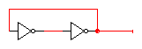
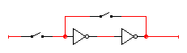
Simplest circuits with feedback
Two inverters form a static memory cell
will hold value as long as it has power applied
How to get a new value into the memory cell?
selectively break feedback path
load new value into cell
"1"
"stored value"
"0"
"remember"
"load"
"stored value"
"data"
Let’s consider a simple memory element first. What if we place two inverters before a stored value and suppose the stored value is 1. Note that there is a feedback from the stored value to the first inverter. Another more sophisticated option is to have a selection function between a stored value and a new value. If “load” is enabled, the new “data” will be put into the stored value.

Slide 4
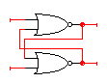
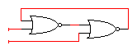
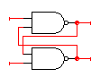
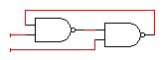
Memory with cross-coupled gates
Cross-coupled NOR gates (R-S Latch)
similar to inverter pair, with capability to force output to 0 (reset=1) or 1 (set=1)
Cross-coupled NAND gates
similar to inverter pair, with capability to force output to 0 (R’=0) or 1 (S’=0)
R
Q
Q'
Q
R
S
S
Q'
S'
Q
Q
Q'
S'
R'
Q'
R'
Let’s consider this feedback in the cases of cross-connectivity between other gate types. With Nor or Nand gates, we can have more control inputs. R and S denote reset and set inputs, respectively. Q is the output value of interest and its inverse is denoted by Q’. For a NOR gate, think of a case when a single input can determine the output of the gate. Suppose R is 1, which makes Q 0. Basically, we assume R and S are opposite for update.

Slide 5
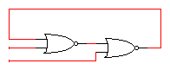
R-S latch analysis
Break feedback path
R
Q
Q(t)
S
Q(t+Δ)
S
Q'
R
S R Q(t) Q(t+Δ) 0 0 0 0 0 0 1 1 0 1 0 0 0 1 1 0 1 0 0 1 1 0 1 1 1 1 0 X 1 1 1 X
hold
S
0 0
1 0
X 1
X 1
reset
Q(t)
set
R
not allowed
characteristic equation
Q(t+Δ) = S + R’ Q(t)
To analyze the timing, let’s assume the feedback loop is cut off. That is, consider Q(t) and Q(t+ ∆) separately. Here ∆ is the delay incurred by the latch. When you look at the truth table, you can notice something different. What is it?
5

Slide 6
Timing behavior
R
Q
S
Q'
Reset
Hold
Set
Reset
Set
100
Race
R
S
Q
\Q
If R=1 and S=0, Q is 0 and Q’ is 1 (recall the meaning of reset R). If R=0 and S=1, Q is 1. What if R=S=0, then Q and Q’ will remain with the previous values.
The problem happens when R=S=1. Are Q and Q’ just 0s? The more significant problem arises when R=S=1 and then R=S=0, which will yield an oscillation as follows. Q and Q’ will be 1 together. But then Q and Q’ should be changed to 0 again. Then this cycle continues.

Slide 7
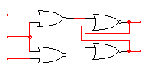
Gated R-S latch
Enable controls when R and S inputs matter
otherwise, the slightest glitch on R or S could cause change in value stored
R
R'
Q
enable’
Q'
S'
S
Set
Reset
100
S'
R'
enable’
Q
Q'
The next version is a gated R-S latch. In the gated (level-sensitive) R-S latch, the R-S values are handled cautiously. When enable’ is high, then R and S are always zeroes (there is no glitch or fluctuation in R and S). So R’ and S’ are meaningful only when enable’ is low. This waveform shows when enable is high and S is set (or S’ is low), Q will become true.

Slide 8
Clocks
Used to keep time
wait long enough for inputs (R' and S') to settle
then allow to have effect on value stored
Clocks are regular periodic signals
period (time between ticks)
duty-cycle (time clock is high between ticks - expressed as % of period)
duty cycle (in this case, 50%)
period
A clock is an important element in sequential circuits. The enable signal in the previous slide serves as kind of a clock. Once enable is asserted, it should remain high until the input stimulates the output fully. Normally, a clock is periodically alternating between high and low. The beginning of each period is called a clock tick. And the duty cycle is defined as the ratio of High voltage interval to the period.

Slide 9
Clocks (cont’d)
Controlling an R-S latch with a clock
Change R and S while clock’ is 1 (inject new input)
only have half of clock period for signal changes to propagate
Keep R and S stable while clock’ is 0 (allowing R and S to pass)
signals must be stable for the other half of clock period
R’
R
Q
clock’
Q’
S’
S
stable
changing
stable
changing
stable
R’ and S’
clock’
Let’s control the gated (or level-sensitive) R-S latch with a clock. While clock’ is 0, R’ and S’ should sustain their values which will update Q and Q’ during that interval. While clock’ is high, R’ and S’ can be changed to a new value (for next operation); in the meantime, Q and Q’ will not change since R and S are 00.

Slide 10
Master-slave structure
Break flow by alternating clocks
use positive clock to latch inputs into one R-S latch
use negative clock to change outputs with another R-S latch
View pair as one basic unit
master-slave flip-flop
twice as much logic
output changes a few gate delays after the falling edge of clock
master stage
slave stage
R
P’
R
Q’
R
Q’
S
S
Q
S
Q
P
CLK

Slide 11
The 1s catching problem
In first R-S stage of master-slave FF
0-1-0 glitch on R or S while clock is high is "caught" by master stage
leads to constraints on logic to be hazard-free
1s catch
master stage
slave stage
Set
Reset
P’
R
R
Q’
R
Q’
S
R
CLK
P
P’
Q
Q’
S
S
Q
P
S
Q
CLK
Master Outputs
Slave Outputs
What would be the problem of the inverted clock signals for the pair of R-S latches? While the clock is high, suppose there is a glitch is in the very first S (0-1-0), P and P’ will change, which in turn will affect the slave latch when the clock becomes low. This is called the 1s catching problem.

Slide 12
D flip-flop
Make S and R complements of each other
eliminates 1s catching problem
can't just hold previous value (must have new value ready every clock period)
value of D just before clock goes low is what is stored in flip-flop
negative edge-triggered
master stage
slave stage
P’
Q’
R
Q’
R
Q’
D
S
Q
S
Q
Q
P
CLK
10 gates
To eliminate the 1s catching problem, we have to make S and R have opposite values; so we use the complementary values from the same input, which is called D flip-flop. D is an abbreviation for data. So R and S can be either 01 and 10 only. Now we cannot use 00 to maintain the same value in the latch. How many gates here? Each R-S latch has two NOR gates.

Slide 13
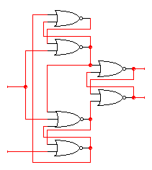
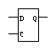
(Negative) Edge-triggered D flip-flops (FFs)
More efficient solution: only 6 gates
sensitive to inputs only near edge of clock signal (not while high)
D’
D
holds D’ when
clock goes low
negative edge-triggered D flip-flop (D-FF)
4-5 gate delays
must respect setup and hold time constraints to successfully capture input
0
R
Q
Clk=1
Q’
S
0
holds D when clock goes low
characteristic equation Q(t+1) = D
D
D’
The other realization to solve the 1s catching problem is to use a clock edge to trigger the change of the flip-flop’s value. While the clock is high, the second top NOR and the second bottom NOR gates will be 0, which keeps the old values of Q and Q’

Slide 14
Negative Edge-triggered D flip-flops (cont’d)
Step-by-step analysis
0
D’
1
0
D’
0
D
1
D
1
1
D’
D’
R
R
Q
Q
Clk=0
Clk=0
1
S
1
S
0
0
1
D
0
D
0
1
1
1→0
D
D’
new D
D’
new D = 1 ≠ old D
when clock goes high-to-low data is latched
when clock is low, data is held
If clock goes from 1 to 0, initially S and R are 0. Then, depending on D’s value, S or R will be changed, which in turn will set or reset Q. The numbers in blue show the case when D is 0. After that, D’s change makes no effect. E.g. new D is 1 now, D (second bottom NOR) was 0, D’(bottom) becomes 0. So D (top) is still 0; R and S are not changed.

Slide 15
Edge-triggered D flip-flops (cont’d)
Positive edge-triggered
inputs sampled on rising edge; outputs change after rising edge
Negative edge-triggered flip-flops
inputs sampled on falling edge; outputs change after falling edge
100
D
CLK
Qpos
Qpos’
Qneg
Qneg’
positive edge-triggered FF
negative edge-triggered FF
There are two kinds of flip-flops which are triggered by the two edges of the signals: rising edge and falling edge. The previous slide shows a negative edge-triggered FF. If we add an inverter to the clock, that FF is turned into a positive edge-triggered FF. Typically, latches are level triggered and simpler. FFs are mostly edge triggered and more complicated.

Slide 16
Edge-triggered D flip-flops (cont’d)
Positive edge-triggered
inputs sampled on rising edge; outputs change after rising edge
Negative edge-triggered flip-flops
inputs sampled on falling edge; outputs change after falling edge
100
D
CLK
Qpos
Qpos’
Qneg
Qneg’
1
1
positive edge-triggered FF
0
negative edge-triggered FF
There are two kinds of flip-flops which are triggered by the two edges of the signals: rising edge and falling edge. The previous slide shows a negative edge-triggered FF. If we add an inverter to the clock, that FF is turned into a positive edge-triggered FF. Typically, latches are level triggered and simpler. FFs are mostly edge triggered and more complicated.

Slide 17
D flip-flop
Make S and R complements of each other
eliminates 1s catching problem
can't just hold previous value (must have new value ready every clock period)
value of D just before clock goes low is what is stored in flip-flop
negative edge-triggered
master stage
slave stage
P’
Q’
R
Q’
R
Q’
D
S
Q
S
Q
Q
1
0
1
P
CLK
10 gates
1
To eliminate the 1s catching problem, we have to make S and R have opposite values; so we use the complementary values from the same input, which is called D flip-flop. D is an abbreviation for data. So R and S can be either 01 and 10 only. Now we cannot use 00 to maintain the same value in the latch. How many gates here? Each R-S latch has two NOR gates.

Slide 18
D flip-flop
Make S and R complements of each other
eliminates 1s catching problem
can't just hold previous value (must have new value ready every clock period)
value of D just before clock goes low is what is stored in flip-flop
negative edge-triggered
master stage
slave stage
P’
Q’
R
Q’
R
Q’
D
S
Q
S
Q
Q
1
1
1
P
CLK
10 gates
0
1
To eliminate the 1s catching problem, we have to make S and R have opposite values; so we use the complementary values from the same input, which is called D flip-flop. D is an abbreviation for data. So R and S can be either 01 and 10 only. Now we cannot use 00 to maintain the same value in the latch. How many gates here? Each R-S latch has two NOR gates.

Slide 19
Edge-triggered D flip-flops (cont’d)
Positive edge-triggered
inputs sampled on rising edge; outputs change after rising edge
Negative edge-triggered flip-flops
inputs sampled on falling edge; outputs change after falling edge
100
D
CLK
Qpos
Qpos’
Qneg
Qneg’
1
0
positive edge-triggered FF
1
negative edge-triggered FF
There are two kinds of flip-flops which are triggered by the two edges of the signals: rising edge and falling edge. The previous slide shows a negative edge-triggered FF. If we add an inverter to the clock, that FF is turned into a positive edge-triggered FF. Typically, latches are level triggered and simpler. FFs are mostly edge triggered and more complicated.

Slide 20
Comparison of latches and flip-flops (FFs)
D Q
D
CLK
Qedge
Qlatch
CLK
positive edge-triggered flip-flop
D Q
C
CLK
transparent (level-sensitive) latch
behavior is the same unless input changes
while the clock is high
Again, in FFs, the data value only at the rising edge (or falling edge) is critical (see blue dots). Meanwhile, most latches are sensitive to D value changes as long as the clock is high. Typically, the clock input of a FF is depicted by a triangle.

Slide 21
Timing Problem
What if input changes at clock edge?
The first latch may not be able to keep the previous or new value
We cannot tell what value the second latch catches
Finally, the D F/F output will be unknown (X)
How can we resolve this timing problem?
→ Stable input at clock edge
master stage
slave stage
P’
Q’
R
Q’
R
Q’
D
S
Q
S
Q
Q
1→?
0→?
1→0
P
CLK
10 gates
1→0
If the input changes values at clock edge, the D F/F will give unknown value
Solution? Stable input at clock edge!
Thus, we have a timing constraint that the input needs to be stable at clock edge.

Slide 22
Timing constraints
Definition of terms
clock: periodic event, causes state of memory element to change can be rising edge or falling edge or high level or low level
setup time: minimum time before the clocking event by which the input must be stable (Tsu)
hold time: minimum time after the clocking event until which the input must remain stable (Th)
T_{su}
T_{h}
data
D
Q
input
clock
there is a timing "window" around
the clocking event during which the
input must remain stable and
unchanged in order to be recognized
clock
stable
changing
data
clock
Let’s go over terminologies first. We already know what is a clock. For each edge of a clock signal, there are some timing constraints. Suppose the positive edge of a clock signal triggers a circuit. Then the data input should be stable for an interval which is Tsu+Th, which are dependent on transistor circuit delay.

Slide 23
Typical timing specifications
Positive edge-triggered D flip-flop
setup (Tsu) and hold (Th) times
Tpd: propagation delays (low to high, high to low, max and typical)
Clock period > Tsu + Tpd
T
su
T
h
T
T
1.8
0.5
su
h
ns
ns
1.8
0.5
D
ns
ns
T
w
T
w
3.3
3.3
Clk
ns
ns
T
pd
T
3.6 ns
Q
pd
1.1 ns
3.6 ns
1.1 ns
all measurements are made from the clocking event (the rising edge of the clock)
This slide illustrates the timing where the rising edge of the clock signal is the reference. Tpd is the propagation delay between the rising edge of the clock (event trigger) and the change in the output. Tw should be long enough to ensure that D will change Q

Slide 24
Propagation Delay
Delay of 2nd latch
After clock goes low, it takes time for the 2nd latch to give the new output
master stage
slave stage
P’
Q’
R
Q’
R
Q’
D
S
Q
S
Q
Q
1
0→1
1
P
CLK
1→0
Tpd

Slide 25
Typical timing specifications
Positive edge-triggered D flip-flop
setup (Tsu) and hold (Th) times
Tpd: propagation delays (low to high, high to low, max and typical)
Clock period > Tsu + Tpd
T
su
T
h
T
T
1.8
0.5
su
h
ns
ns
1.8
0.5
D
ns
ns
T
w
T
w
3.3
3.3
Clk
ns
ns
T
pd
T
3.6 ns
Q
pd
1.1 ns
3.6 ns
1.1 ns
all measurements are made from the clocking event (the rising edge of the clock)
This slide illustrates the timing where the rising edge of the clock signal is the reference. Tpd is the propagation delay between the rising edge of the clock (event trigger) and the change in the output. Tw should be long enough to ensure that D will change Q

Slide 26
Cascading Edge-triggered Flip-Flops
Shift register
New value goes into first stage
While previous value of first stage goes into second stage
Consider setup/hold/propagation delays (Tpd must be > Th)
Q0
Q1
IN
D
Q
D
Q
OUT
CLK
100
IN
Q0
Q1
CLK

Slide 27
Cascading Edge-triggered Flip-Flops (cont’d)
Why this works
Propagation delays exceed hold times
Clock width constraint exceeds setup time
This guarantees following stage will latch current value before it changes to new value
In
Q0
Q1
CLK
D’
D
T_{su}
4ns
T_{su}
4ns
timing constraints
guarantee proper
operation of
cascaded components
0
R
Q
T_{p}
3ns
T_{p}
3ns
Clk=1
Q’
S
0
assumes infinitely fast distribution of the clock
D
D’
T_{h}
2ns
T_{h}
2ns

Slide 28
Timing Methodologies
F/F-controlled system (positive edge triggered)
data1
data2
D
Q
D
Q
clock
Positive edge-triggered
stable
changing
data1 & 2
clock
Setup time violation
Hold time violation

Slide 29
Verilog Code #2: Sequential Logic
Flip-flops
Memory elements
Shift registers
Counters

Slide 30
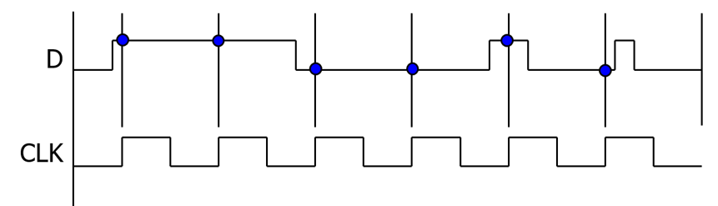
D-Type Flip-Flops
// D-type flip-flop
module DFF (clk, d, q);
input clk, d;
output reg q;
always @(posedge clk) q <= d;
endmodule
q

Slide 31
Asynchronous Reset D-Type Flip-Flops
// asynchronous reset D-type flip-flop
module DFF_async_reset (clk, reset_n, d, q);
input clk, reset_n, d;
output reg q;
always @(posedge clk or negedge reset_n)
if (!reset_n) q <= 0;
else q <= d;
endmodule
reset_n
X
q
O
q

Slide 32
Synchronous Reset D-Type Flip-Flops
// synchronous reset D-type flip-flop
module DFF_sync_reset (clk, reset_n, d, q);
input clk, reset_n, d;
output reg q;
always @(posedge clk)
if (!reset_n) q <= 0;
else q <= d;
endmodule
reset_n
q

Slide 33
Sequential Logic
Flip-flops
Memory elements
Shift registers
Counters

Slide 34
Registers
Collections of flip-flops with similar controls and logic
stored values somehow related (for example, form binary value)
share clock, reset, and set lines
similar logic at each stage
Examples
shift registers
counters
OUT1
OUT2
OUT3
OUT4
"0"
R
S
R
S
R
S
R
S
D
Q
D
Q
D
Q
D
Q
CLK
IN1
IN2
IN3
IN4
From now on, we will look at a collection of FFs. The first memory element to look at is a register. A register is normally defined as a group of FFs with coordinated controls or shared controls. Examples of controls are clock, reset, set and so on. In this case, we can read/write 4 bits in parallel.

Slide 35
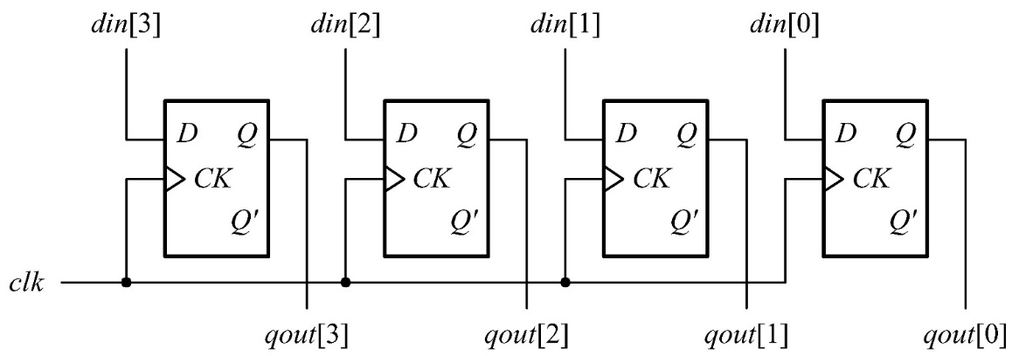
Data Registers
// D-type flip-flop
module DFF (clk, din, qout);
input clk, din;
output reg qout;
always @(posedge clk) qout <= din;
endmodule

Slide 36
Data Registers
// an n-bit data register
module register(clk, din, qout);
parameter N = 4; // number of bits
…
input [N-1:0] din;
output reg [N-1:0] qout;
always @(posedge clk) qout <= din;
endmodule

Slide 37
Data Registers
// an N-bit data register with asynchronous reset
module register_reset (clk, reset_n, din, qout);
parameter N = 4; // number of bits
…
input [N-1:0] din;
output reg [N-1:0] qout;
always @(posedge clk or negedge reset_n)
if (!reset_n) qout <= {N{1'b0}};
else qout <= din;
endmodule

Slide 38
Data Registers
// an N-bit data register with synchronous load and asynchronous reset
module register_load_reset (clk, load, reset_n, din, qout);
parameter N = 4; // number of bits
input clk, load, reset_n;
input [N-1:0] din;
output reg [N-1:0] qout;
always @(posedge clk or negedge reset_n)
if (!reset_n) qout <= {N{1'b0}};
else if (load) qout <= din;
endmodule

Slide 39
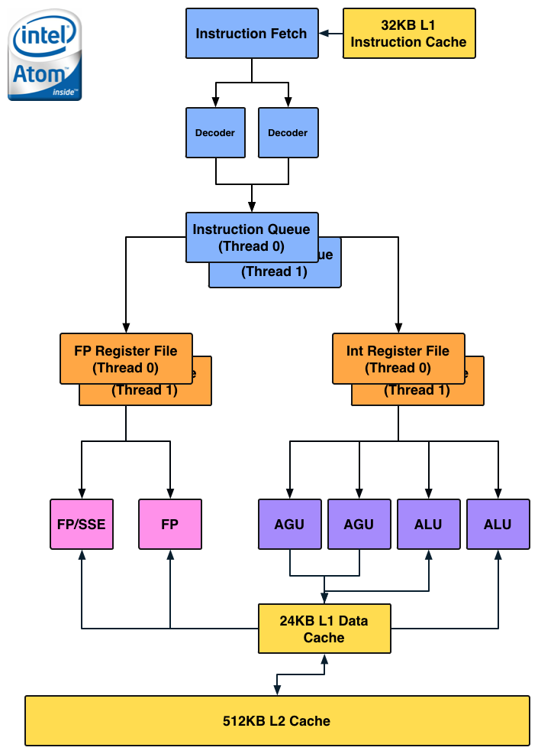
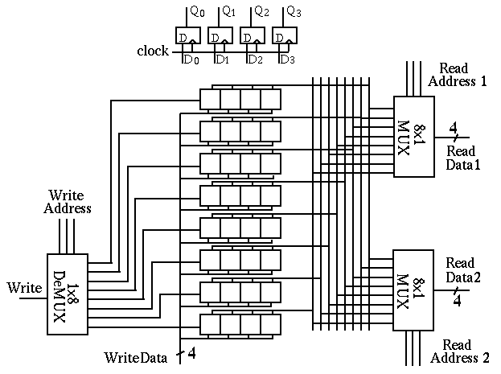
Register File
[Intel] [http://fourier.eng.hmc.edu/e85_old/lectures/figures/register_file_diagram_0.gif]
A key component in CPU
A set of registers + Mux/DeMux

Slide 40
A Register File (having 16 8-bit Words)
// an N-word register file with one-write and two-read ports
parameter M = 4; // number of address bits
parameter N = 16; // number of words, N = 2^M
parameter W = 8; // number of bits in a word
input clk, wr_enable;
input [W-1:0] din;
output [W-1:0] douta, doutb;
input [M-1:0] rd_addra, rd_addrb, wr_addr;
reg [W-1:0] reg_file [N-1:0];
…
assign douta = reg_file[rd_addra];
assign doutb = reg_file[rd_addrb];
always @(posedge clk)
if (wr_enable) reg_file[wr_addr] <= din;
1 word = 8bits
16 words

Slide 41
A Register File (having 16 8-bit Words)
// an N-word register file with one-write and two-read ports
parameter M = 4; // number of address bits
parameter N = 16; // number of words, N = 2^M
parameter W = 8; // number of bits in a word
input clk, wr_enable;
input [W-1:0] din;
output [W-1:0] douta, doutb;
input [M-1:0] rd_addra, rd_addrb, wr_addr;
reg [W-1:0] reg_file [N-1:0];
…
assign douta = reg_file[rd_addra];
assign doutb = reg_file[rd_addrb];
always @(posedge clk)
if (wr_enable) reg_file[wr_addr] <= din;
clk
wr_enable
wr_addr
din
rd_addra
douta
rd_addrb
doutb

Slide 42
A Register File
// an N-word register file with one-write and two-read ports with read_en
parameter M = 4; // number of address bits
parameter N = 16; // number of words, N = 2^M
parameter W = 8; // number of bits in a word
input clk, wr_enable, read_en_a, read_en_b;
input [W-1:0] din;
output [W-1:0] douta, doutb;
input [M-1:0] rd_addra, rd_addrb, wr_addr;
reg [W-1:0] reg_file [N-1:0];
…
assign douta = read_en_a ? _________________________;
assign doutb = read_en_b ? _________________________;
always @(posedge clk)
if (wr_enable) reg_file[wr_addr] <= din;
clk
wr_enable
wr_addr
din
rd_addra
douta
rd_addrb
doutb
read_en_a
read_en_b

Slide 43
Register File
[Intel] [http://fourier.eng.hmc.edu/e85_old/lectures/figures/register_file_diagram_0.gif]
A key component in CPU
A set of registers + Mux/DeMux

Slide 44
A Synchronous RAM (Random Access Memory)
// a synchronous RAM module example
parameter N = 16; // number of words
parameter A = 4; // number of address bits
parameter W = 8; // number of wordsize in bits
input [A-1:0] addr;
input [W-1:0] din;
input cs, wr, clk; //chip select, read-write control, and clock signals
output reg [W-1:0] dout;
reg [W-1:0] ram[N-1:0]; // declare an N * W memory array
always @(posedge clk)
if (cs) begin
if (wr) ram[addr] <= din;
else dout <= ram[addr];
end

Slide 45
Sequential Logic
Flip-flops
Memory elements
Shift registers
Counters

Slide 46
Shift register
Holds samples of input
store last 4 input values in sequence
4-bit shift register:
OUT1
OUT2
OUT3
OUT4
IN
D
Q
D
Q
D
Q
D
Q
CLK
One of the relatively simple registers is a shift register. Here one bit is shifted (or moved to right) to the next FF at each clock tick (its positive edge). At each positive edge, the stored value will come out and move to the next element.

Slide 47
Shift register application
Parallel-to-serial conversion for serial transmission
parallel outputs
parallel inputs
serial transmission
One of the popular applications of the shift register is serial transmission, where information is transmitted over the medium bit-by-bit.

Slide 48
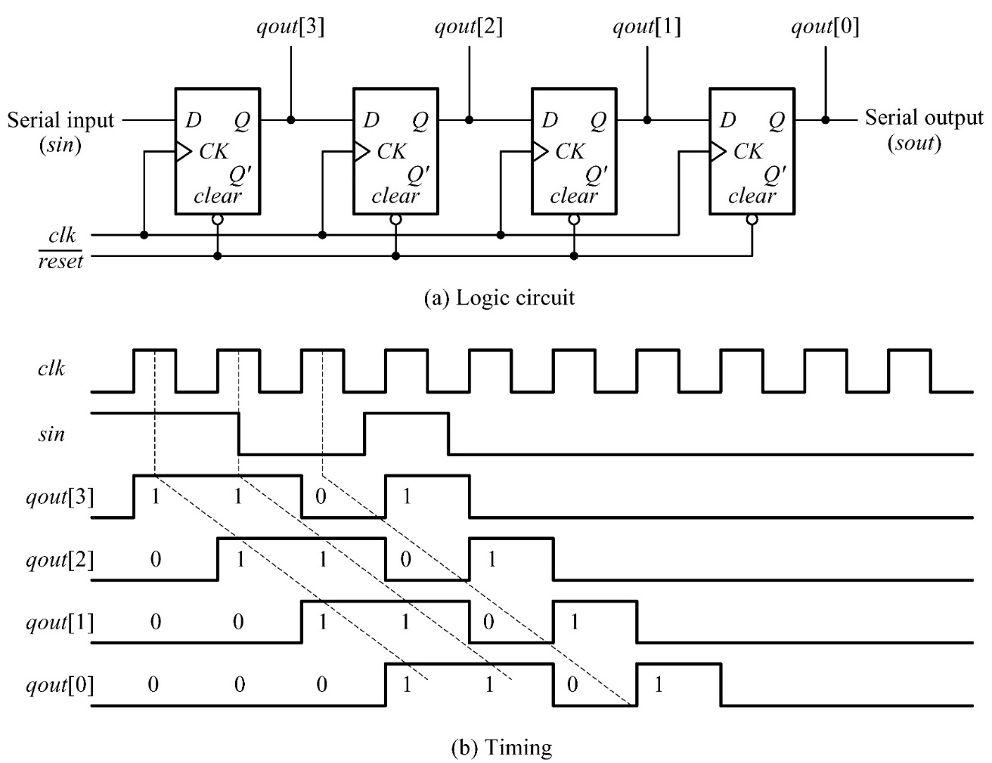
Shift Registers

Slide 49
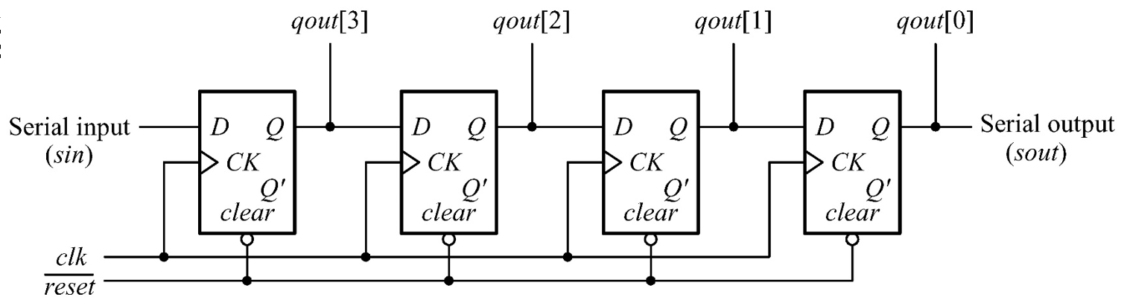
Shift Registers
// a shift register module example
module shift_register(clk, reset_n, sin, qout);
parameter N = 4; // number of bits
input clk, reset_n, sin;
output reg [N-1:0] qout;
always @(posedge clk or negedge reset_n)
if (!reset_n) qout <= {N{1'b0}};
else qout <= {sin, qout[N-1:1]};
endmodule

Slide 50
Shift Registers
// a shift register with parallel load module example
module shift_register_parallel_load (clk, load, reset_n, sin, din, qout);
parameter N = 8; // number of bits
input clk, load, reset_n, sin;
input [N-1:0] din;
output reg [N-1:0] qout;
always @(posedge clk or negedge reset_n)
if (!reset_n) qout <= {N{1'b0}};
else if (load) qout <= din;
else qout <= {sin, qout[N-1:1]};

Slide 51
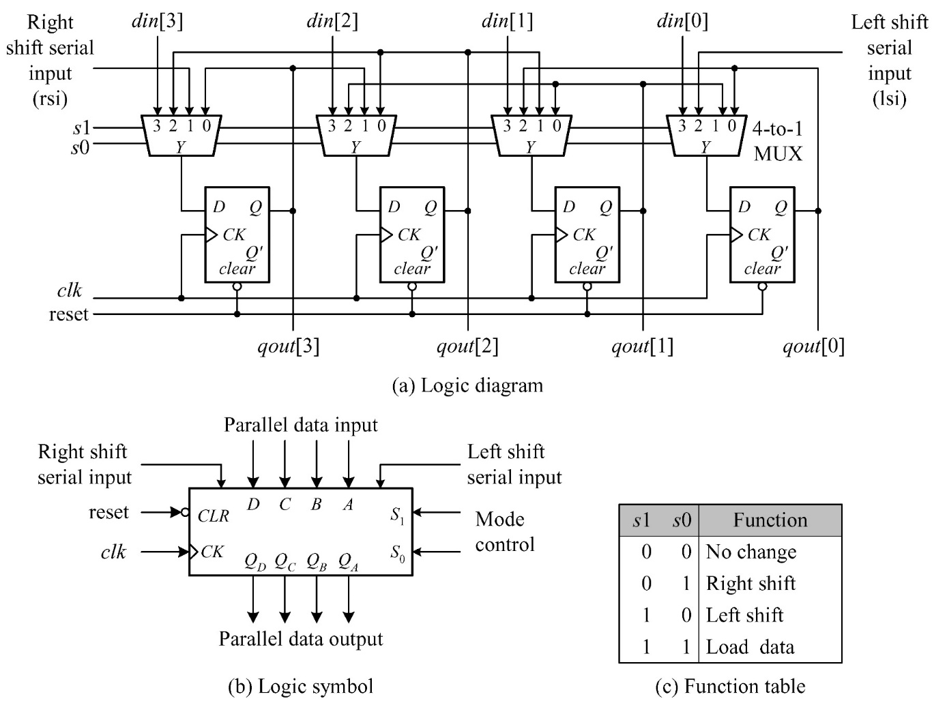
Universal Shift Registers

Slide 52
Universal Shift Registers
// a universal shift register module
module universal_shift_register (clk, reset_n, s1, s0, lsi, rsi, din, qout);
parameter N = 4; // define the default size
input clk, reset_n, s1, s0, lsi, rsi;
input [N-1:0] din;
output reg [N-1:0] qout;
always @(posedge clk or negedge reset_n)
if (!reset_n) qout <= {N{1'b0}};
else case ({s1,s0})
2'b00: ; // qout <= qout; // No change
2'b01: qout <= {lsi, qout[N-1:1]}; // Shift right
2'b10: qout <= {qout[N-2:0], rsi}; // Shift left
2'b11: qout <= din; // Parallel load
endcase
endmodule

Slide 53
Pattern recognizer
Combinational function of input samples
in this case, recognizing the pattern 1001 on the single input signal
OUT
OUT1
OUT2
OUT3
OUT4
IN
D
Q
D
Q
D
Q
D
Q
CLK
Another useful application of shift registers is bit string identification. In this case, bits are shifted from left to right. At any moment, if 4 bits are 1001, then OUT will be true.

Slide 54
Sequential Logic
Flip-flops
Memory elements
Shift registers
Counters

Slide 55
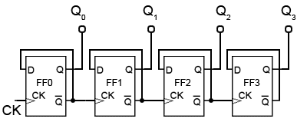
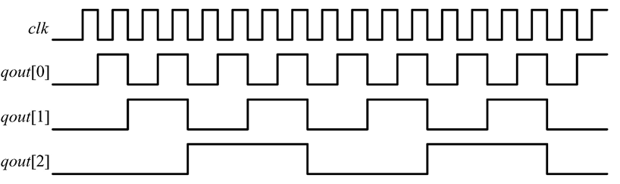
Binary Ripple Counters

Slide 56
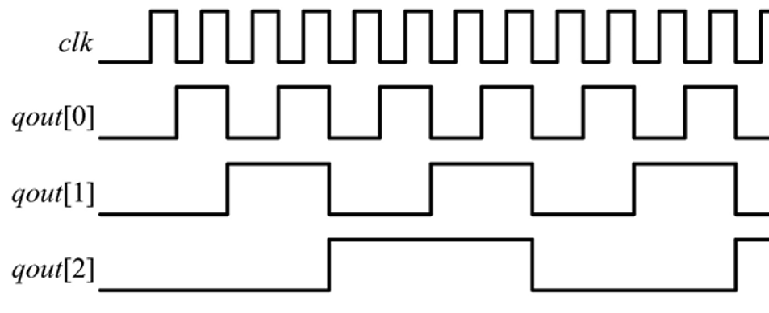
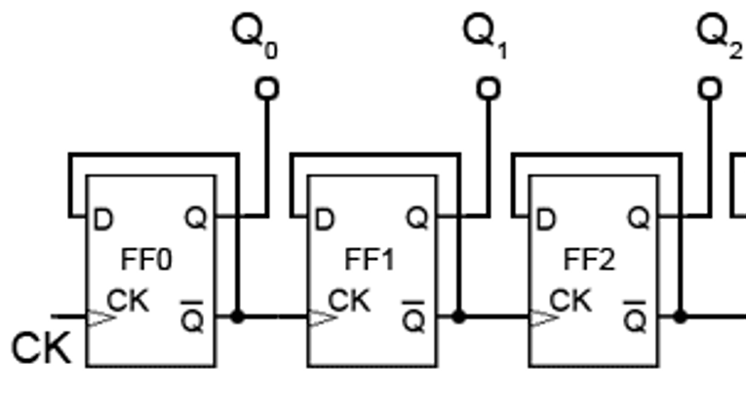
Binary Ripple Counters
// a 3-bit ripple counter module example
module ripple_counter(clk, qout);
input clk;
output reg [2:0] qout;
wire c0, c1;
// the body of the 3-bit ripple counter
assign c0 = qout[0], c1 = qout[1];
always @(negedge clk)
qout[0] <= ~qout[0];
always @(negedge c0)
qout[1] <= ~qout[1];
always @(negedge c1)
qout[2] <= ~qout[2];
C0
C1
C0
C1

Slide 57
Binary Ripple Counters
// a 3-bit ripple counter with enable control
module ripple_counter_enable(clk, enable, reset_n, qout);
input clk, enable, reset_n;
output reg [2:0] qout;
wire c0, c1;
assign c0 = qout[0], c1 = qout[1];
always @(posedge clk or negedge reset_n)
if (!reset_n) qout[0] <= 1'b0;
else if (enable) qout[0] <= ~qout[0];
always @(posedge c0 or negedge reset_n)
if (!reset_n) qout[1] <= 1'b0;
else if (enable) qout[1] <= ~qout[1];
always @(posedge c1 or negedge reset_n)
if (!reset_n) qout[2] <= 1'b0;
else if (enable) qout[2] <= ~qout[2];

Slide 58
Binary Ripple Counters
// an N-bit ripple counter using generate blocks
parameter N = 4; // define the size of counter
…
output reg [N-1:0] qout;
genvar i;
generate for (i = 0; i < N; i = i + 1) begin: ripple_counter
if (i == 0) // specify LSB
always @(negedge clk or negedge reset_n)
if (!reset_n) qout[0] <= 1'b0; else qout[0] <= ~qout[0];
else // specify the rest bits
always @(negedge qout[i-1] or negedge reset_n)
if (!reset_n) qout[i] <= 1'b0; else qout[i] <= ~qout[i];
end endgenerate

Slide 59
Binary Up/Down Counters
module updn_bincounter (clk, reset, eup, edn, qout, cout, bout);
parameter N = 4;
input clk, reset, eup, edn;
output reg [N-1:0] qout;
output cout, bout;
always @(posedge clk)
if (reset) qout <= {N{1'b0}}; // synchronous reset
else if (eup) qout <= qout + 1;
else if (edn) qout <= qout - 1;
assign #1 cout = (&qout)& eup; // generate carry out
assign #1 bout = (~|qout)& edn; // generate borrow out

Slide 60
Ring counters
Sequences through a fixed set of patterns
in this case, 1000, 0100, 0010, 0001
if one of the patterns is its initial state (by loading or set/reset)
OUT1
OUT2
OUT3
OUT4
1
0
0
0
IN
D
Q
D
Q
D
Q
D
Q
CLK
If there are multiple patterns that are used for state representation, this register is typically referred to as a counter. Look at the shift register in the slide. Suppose there is a initialization (or preset) logic that stores 1000 in the register, which is not shown here. Then, as the clock ticks, the bits are rotating this ring. That’s why it is called a ring counter.

Slide 61
Ring counters
Sequences through a fixed set of patterns
in this case, 1000, 0100, 0010, 0001
if one of the patterns is its initial state (by loading or set/reset)
OUT1
OUT2
OUT3
OUT4
0
1
0
0
IN
D
Q
D
Q
D
Q
D
Q
CLK
If there are multiple patterns that are used for state representation, this register is typically referred to as a counter. Look at the shift register in the slide. Suppose there is a initialization (or preset) logic that stores 1000 in the register, which is not shown here. Then, as the clock ticks, the bits are rotating this ring. That’s why it is called a ring counter.

Slide 62
Ring counters
Sequences through a fixed set of patterns
in this case, 1000, 0100, 0010, 0001
if one of the patterns is its initial state (by loading or set/reset)
OUT1
OUT2
OUT3
OUT4
0
0
1
0
IN
D
Q
D
Q
D
Q
D
Q
CLK
If there are multiple patterns that are used for state representation, this register is typically referred to as a counter. Look at the shift register in the slide. Suppose there is a initialization (or preset) logic that stores 1000 in the register, which is not shown here. Then, as the clock ticks, the bits are rotating this ring. That’s why it is called a ring counter.

Slide 63
Activity
How does this counter work? (initial value: 1000)
OUT1
OUT2
OUT3
OUT4
IN
D
Q
D
Q
D
Q
D
Q
CLK
Counts through the sequence: 1000, 1100, 1110, 1111, 0111, 0011, 0001, 0000
Known as Mobius (or Johnson) counter

Slide 64
Four-bit binary synchronous up-counter
Standard component with many applications
positive edge-triggered FFs w/ synchronous load and clear inputs
parallel load data from D, C, B, A
enable inputs: must be asserted to enable counting
ripple-carry out (RCO) is used for cascading counters
high when counter is in its highest state 1111
implemented using an AND gate
EN D C B A
LOAD
CLK
CLR
Preset
logic
(2) RCO goes high
RCO
QD QC QB QA
(3) High order 4-bits are incremented
(1) Low order 4-bits = 1111
If we use the binary counter in the previous slide as a basic component, we can build many complicated circuits, e.g. a wider binary counter. Here D is the MSB.

Slide 65
Offset counters
"1"
"0" "1" "1" "0"
EN
D C B A
LOAD
CLK
CLR
Starting offset counters – use of synchronous load
e.g., 0110, 0111, 1000, 1001, 1010, 1011, 1100, 1101, 1111, 0110, . . .
Ending offset counter – comparator for ending value
e.g., 0000, 0001, 0010, ..., 1100, 1101, 0000
Combinations of the above (start and stop value)
RCO
QD QC QB QA
"0"
"1"
"0" "0" "0" "0"
EN
D C B A
LOAD
CLK
CLR
RCO
QD QC QB QA
Other examples are here; using the load input, we can control the initial value. Or by using some product term from the stored values, we can configure the ending value of the counter.

Slide 66
Activity
Design a 4-bit incrementing counter whose values range between 0010 and 1110
"1"
"0" "0" "0" "0"
EN
D C B A
LOAD
CLK
CLR
RCO
QD QC QB QA
?
?
?

Slide 67
Activity
Design a 4-bit incrementing counter whose values range between 0010 and 1110
"1"
"0" "0" "0" "0"
EN
D C B A
LOAD
CLK
CLR
"1"
"0" "0" “1" "0"
EN
D C B A
LOAD
CLK
CLR
RCO
QD QC QB QA
RCO
QD QC QB QA
?
?
?

Slide 68
Design of a 4-bit incrementing counter (0010 ~ 1110) in Verilog
수범 여기 앞의 예제에 대한 Verilog code 추가하기 바래

Slide 69
ALU + Register File in CPU Design
수범, term project으로 설계하는 CPU의 ALU 부분과 register file을 여기서 공부하게 하려고 해
ALU in Verilog
Term project에서 쓰는 것과 조금 다르게
Register file in Verilog
Term project에서 쓰는 것과 조금 다르게
Top에서 이 2개를 연결하고 test bench에서 ALU와 Register File에 control signal을 보내는 예제 코드 준비해 주기 바래

Slide 70
Metastability and Asynchronous inputs
Clocked synchronous circuits
Inputs, state, and outputs sampled or changed in relation to a common reference signal (called the clock)
E.g., master/slave, edge-triggered
Asynchronous circuits
Inputs, state, and outputs sampled or changed independently of a common reference signal (glitches/hazards a major concern)
E.g., R-S latch
Asynchronous inputs to synchronous circuits
Inputs can change at any time, will not meet setup/hold times
Dangerous, synchronous inputs are greatly preferred
Cannot be avoided (e.g., reset signal, memory wait, user input)

Slide 71
Typical timing specifications
Positive edge-triggered D flip-flop
setup (Tsu) and hold (Th) times
Tpd: propagation delays (low to high, high to low, max and typical)
Clock period > Tsu + Tpd
T
su
T
h
T
T
1.8
0.5
su
h
ns
ns
1.8
0.5
D
ns
ns
T
w
T
w
3.3
3.3
Clk
ns
ns
T
pd
T
3.6 ns
Q
pd
1.1 ns
3.6 ns
1.1 ns
all measurements are made from the clocking event (the rising edge of the clock)
This slide illustrates the timing where the rising edge of the clock signal is the reference. Tpd is the propagation delay between the rising edge of the clock (event trigger) and the change in the output. Tw should be long enough to ensure that D will change Q

Slide 72
Timing Methodologies
F/F-controlled system (positive edge triggered)
data1
data2
D
Q
D
Q
clock
Positive edge-triggered
stable
changing
data1 & 2
clock
Setup time violation
Hold time violation

Slide 73
Handling Asynchronous Inputs
What can go wrong?
Input changes too close to clock edge (violating setup time constraint)
In
D
Q
Q0
Clock
D
Q
Q1
Clock
In
Q0
Q1
CLK
In is asynchronous and fans out to D0 and D1 one FF catches the signal, one does not
inconsistent state may be reached!
Tsu
Th

Slide 74
Synchronization Failure
Occurs when FF input changes close to clock edge
FF may enter a metastable state – neither a logic 0 nor 1 –
May stay in this state an indefinite amount of time
Is not likely in practice but has some probability
logic 1
logic 0
logic 1
logic 0
small, but non-zero probability that the FF output will get stuck in an in-between state
oscilloscope traces demonstrating
synchronizer failure and eventual
decay to steady state

Slide 75
Dealing with Synchronization Failure
Probability of failure can never be reduced to 0, but it can be reduced
(1) slow down the system clock: this gives the synchronizer more time to decay into a steady state; synchronizer failure becomes a big problem for very high speed systems
(2) use fastest possible logic technology in the synchronizer: this makes for a very sharp "peak" upon which to balance
(3) cascade two synchronizers: this effectively synchronizes twice (both would have to fail)
asynchronous
input
D
Q
Q
synchronized
input
D
Clk
synchronous system

Slide 76
Handling Asynchronous Inputs
Never allow asynchronous inputs to fan-out to more than one flip-flop
Synchronize as soon as possible and then treat as synchronous signal
Clocked
Synchronizer
Synchronous
System
Async
Q0
Async
D
Q
D
Q
Q0
Input
D
Q
Input
Clock
Clock
D
Q
Q1
D
Q
Q1
Clock
Clock

Slide 77
Sequential logic summary
Fundamental building block of circuits with state
latch and flip-flop
R-S latch, R-S master/slave, D master/slave, edge-triggered D flip-flop
Timing methodologies
use of clocks
Setup and hold times around the clock edge
Basic registers
shift registers
counters

Slide 78
Appendix

Slide 79
Storage Elements
Memory in Computer System
Fetch/decode
Inst cache
Register
file
ALU
LD/ST
Data cache
Latch and flip-flop
Register file, pipe stage, …
SRAM (static random access memory)
Cache or large register file
DRAM (dynamic random access memory)
Main memory or large cache
Flash memory
Storage
CPU
L2 cache
L3 cache
WL
WL
Main memory
BL
BL
Storage
BL
WL
BL
WL

Slide 80
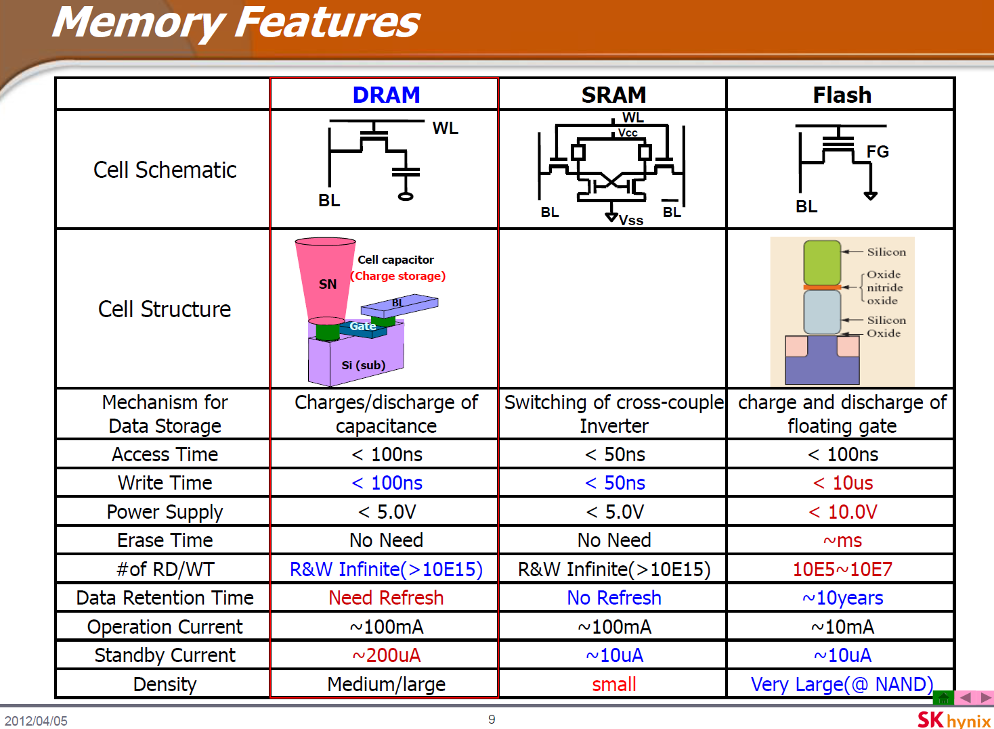

Slide 81
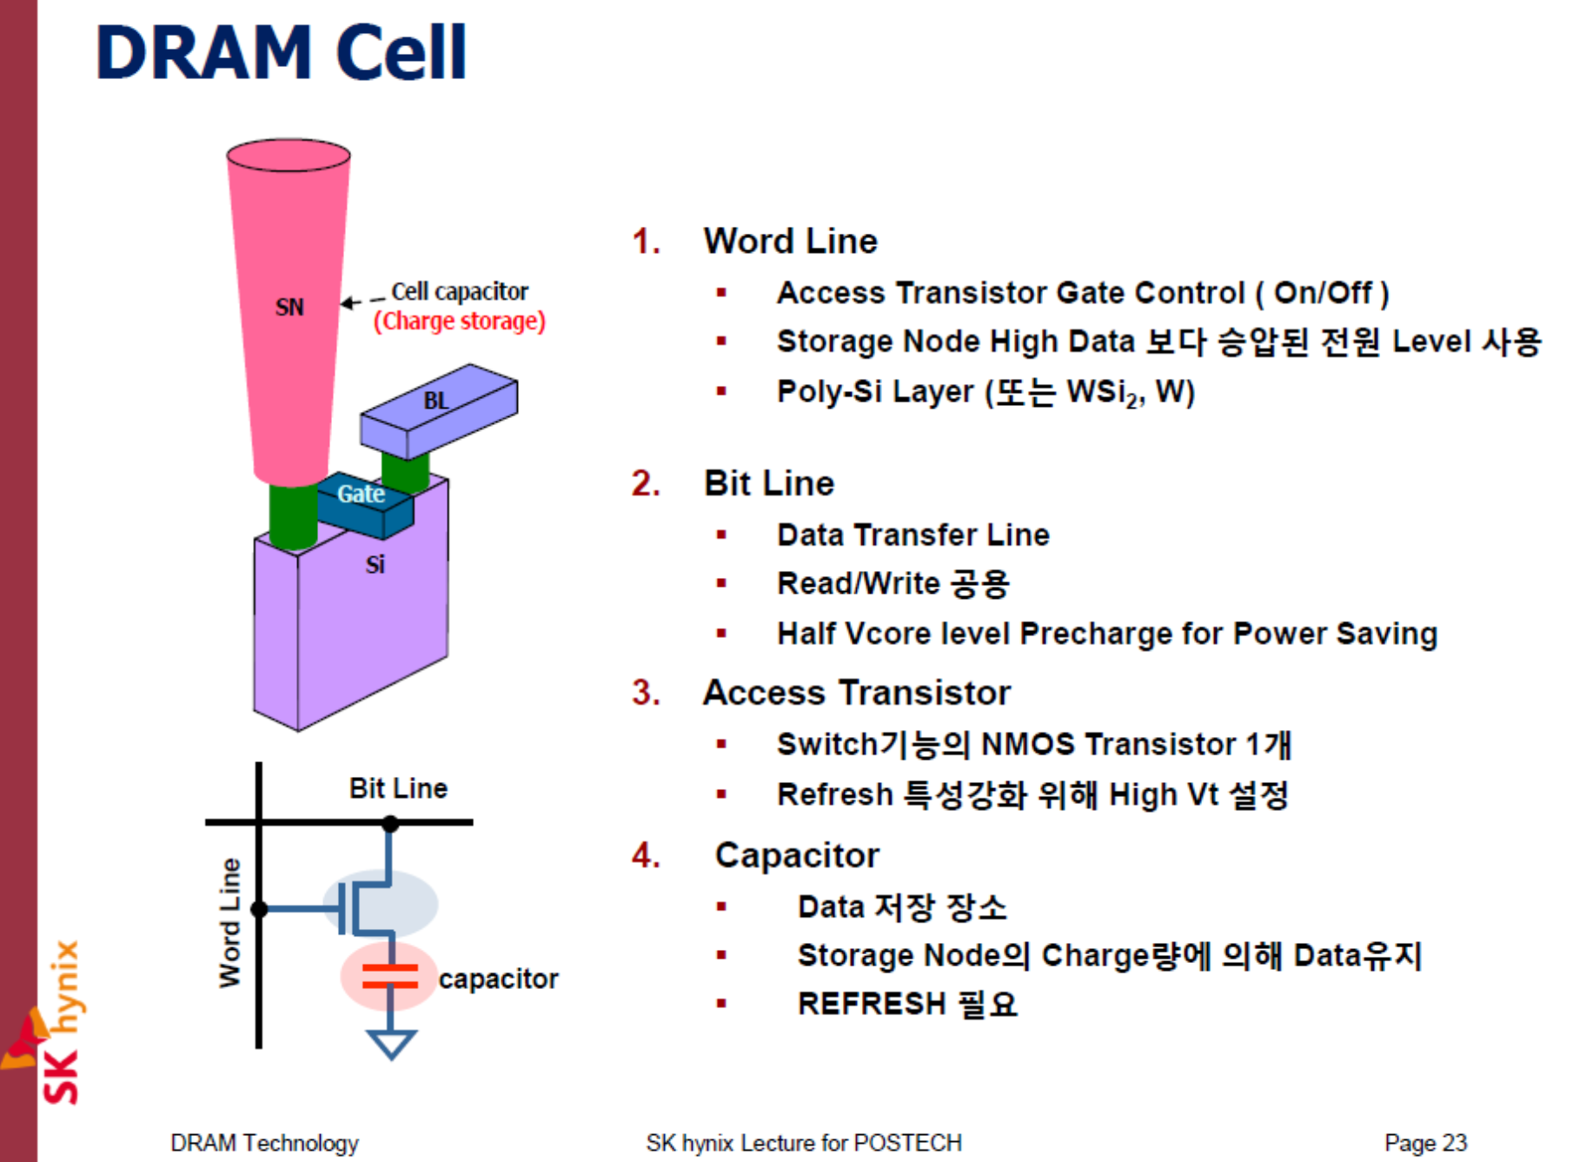

Slide 82
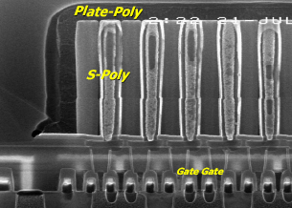
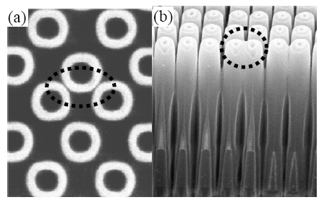
DRAM Scaling Limit
[ITRS, 2010]
Year | 2010 | 2011 | 2012 | 2013 | 2014 | 2015 | 2016 | 2017 | 2018 | 2019 | 2020
DRAM ½ Pitch (nm) | 45 | 40 | 36 | 32 | 28 | 25 | 23 | 20 | 18 | 16 | 14
Manufacturable sol. | Exist |  |  | Known |  |  |  | NOT known
❑ RCAT DRAM Structure
❑ Capacitor lean (Cylinder > 2 um)
1.6 μm
cap
n⁺
poly-Si
gate
n⁺
source
> 2.0 μm
n⁺
drain
p-type Si sub.
scalability limit: < 15 nm

Slide 83
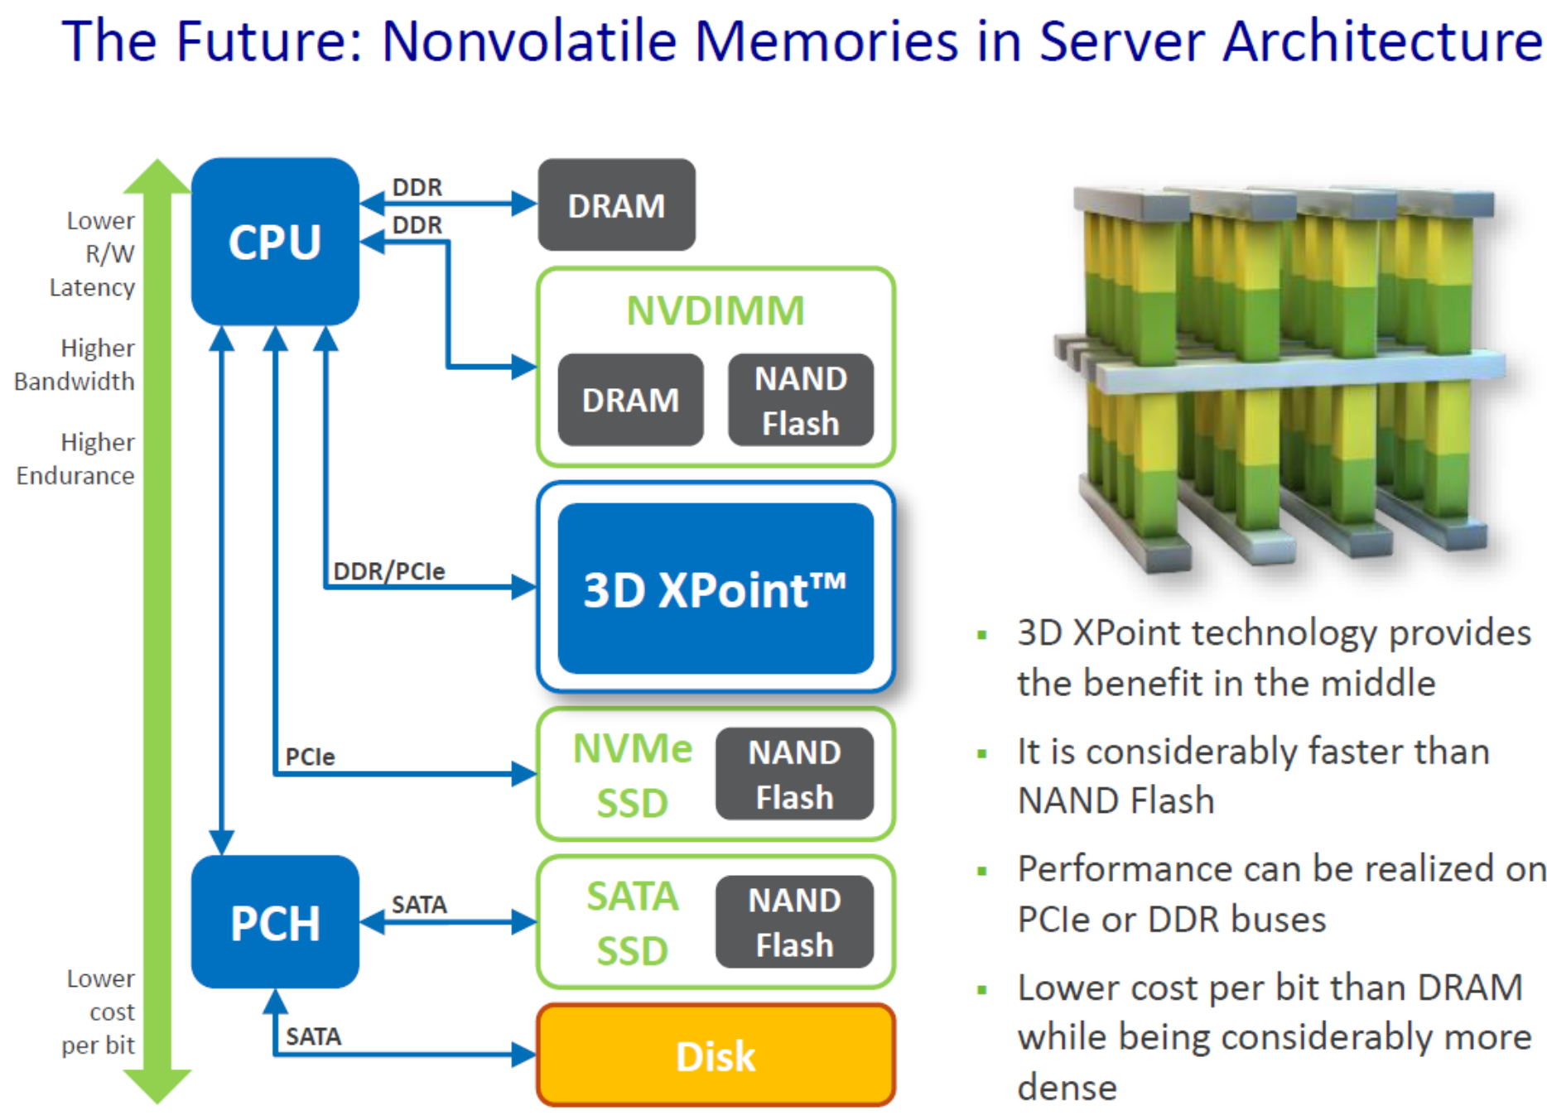
Intel 3D XPoint

Slide 84
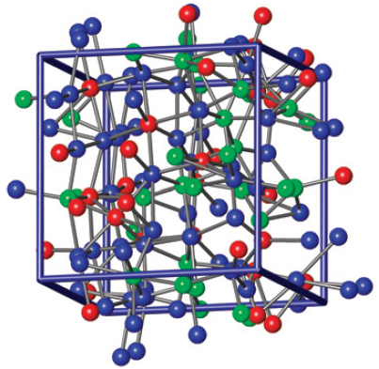
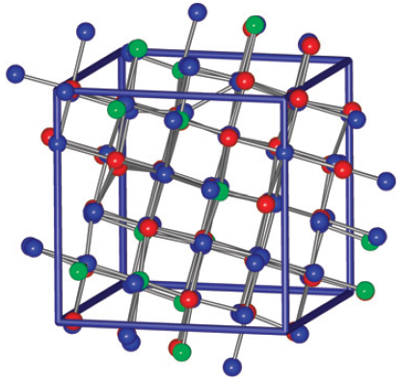
Phase-change RAM (PCM)
bit line
V_{CC}
current
pulse
source
top
electrode
GST
memory
metal
V_{gate}
select TR
SET
RESET
Amorphous = high resistivity
Crystalline = low resistivity
(Pictures from Hegedüs and Elliott, Nature Materials, March 2008)

Slide 85
Appendix

Slide 86
What is HDL / Verilog
Why use HDL (Hardware Description Language)?
Design can be described at a very abstract level
Functional verification can be done early in the design cycle
Reduce cost and time to design hardware
Verilog is one of the most popular HDLs
Allowing different levels of abstraction in the same module
A general-purpose, easy to learn, and easy to use HDL language
Key features of Verilog
Supports various levels of abstraction
Behavior level
Register transfer level
Gate level
Simulate design functions
Combines structural and behavioral modeling styles

Slide 87
HDL-Based Design Flow
Coverage in our practice class
Behavioral/RTL Modeling (HDL)
Verify timing constraints
Functional Simulation
Bit-stream Generation
Hardware Specification Using C or Matlab
Synthesis
FPGA test
Gate-level Simulation
ASIC Design
Place & Route

Slide 88
Number Representation
<size><base format><number>
<size> : Number of bits (optional)
<base format> : Single character (b, d, o, and h)
<number> : Contains digits which are legal for the <base format>
Examples
549 // decimal number
‘h8FF // hex number
‘o765 // octal number
4’b11 // 4-bit binary number 0011
3’b10x // 3-bit binary number with least significant bit unknown
5’d3 // 5-bit decimal number
-4’b11 // 4-bit two’s complement of 0011, or equivalently 1101

Slide 89
Number Representation
Sized number
<size>`<base format><number>
4`b1001
16`habcd
Unsized number: 32bit
`<base format><number>
2009
`habc
x or z
x: an unknown value
z: a high impedance

Slide 90
Number Representation
Verilog’s nets and registers hold four-valued data
0
Obvious, logic 0, false condition
1
Obvious, logic 1, true condition
Z
Output of an undriven tri-state driver
Models case where nothing is setting a wire’s value
X
Models when the simulator can’t decide the value
Initial state of registers
When a wire is being driven to 0 and 1 simultaneously
Output of a gate with Z inputs

Slide 91
Two Main Data Types
Nets(wire) represent connections between things
Do not hold their value
Take their value from a driver such as a gate or other module
Cannot be assigned in an initial or always block
Regs(reg) represent data storage
Behave exactly like memory in a computer
Hold their value until explicitly assigned in an initial or always block
Never connected to something
Can be used to model latches, flip-flops, etc.
Shared variables with all their attendant problems
A variable of type register does not necessary represent a physical register

Slide 92
The integer and time Variables
Integer variable
Contains integer values
Has at least 32 bits
Is treated as a signed reg variable
integer i, j;
integer data[7:0];
Time variable
Used for storing and manipulating simulation time
Used in conjunction with the $time system task
Only unsigned value and at least 64 bits
time events;
time current_time;

Slide 93
Data Declaration
Size of register or wire
reg [0:7] A, B; // A and B are 8-bit wide with MSB as 0th bit
wire [3:0] Dout; // Dout is a 4-bit wire
reg [7:0] C; // C is 8-bit register with MSB as the 8th bit
Assignments and concatenations
A = 8’b0101_1010;
B = {A[3:0] | A[7:4], 4’b0000};
B is set to the 1st 4-bit of A bitwise or-ed with the last 4-bit of A and then concatenated with 0000.
{} brackets means the bits of the 2 or more arguments separated by commas are concatenated together.

Slide 94
Vectors
A vector = multiple bit width
[high:low] or [low:high]
The leftmost bit is the MSB
include nets and reg data types
A scalar = 1-bit vector
Array and Memory Elements
All net and variable data types are allowed
An array element can be a scalar or a vector
wire a[3:0];
reg d[7:0];
wire [7:0] x[3:0];
reg [31:0] y[15:0];
integer states [3:0];
time current[5:0];

Slide 95
Memory
Memory
model ROM, RAM, or register files
reg [7:0] mema [7:0];
reg [7:0] memb [3:0][3:0];
wire sum [7:0][3:0];
mema[4][3]
mema[5][7:4]
memb[3][1][1:0]
sum[5][0]

Slide 96
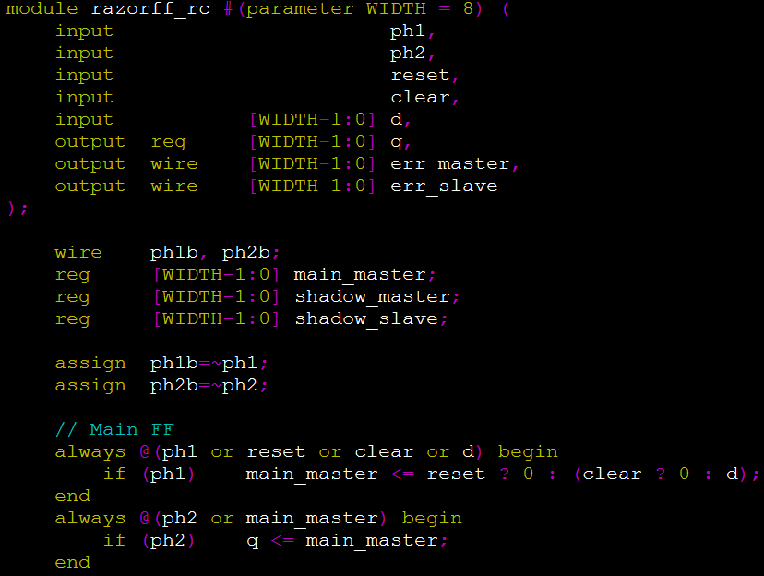
‘assign’
Lvalue, Rvalue
Lvalue: wire
Rvalue: wire, reg
Connecting wire physically

Slide 97
Basic Grammars
Describe a system by a set of modules
Equivalent to functions in ‘C’
Keywords
E.g., module, are reserved in all lower case letter
Operators (some examples)
Arithmetic: +, -, *, /, !, ~
Binary operators: &, |, ^, ~(bitwise), !(logical)
Shift: <<, >>
Relational: <, <=, >, >=, ==, !=
Logical: &&, ||
Identifiers
Equivalent to variable names
Identifiers can be up to 1024 characters
Comments
“//” for 1-line or /* to */ across several lines

Slide 98
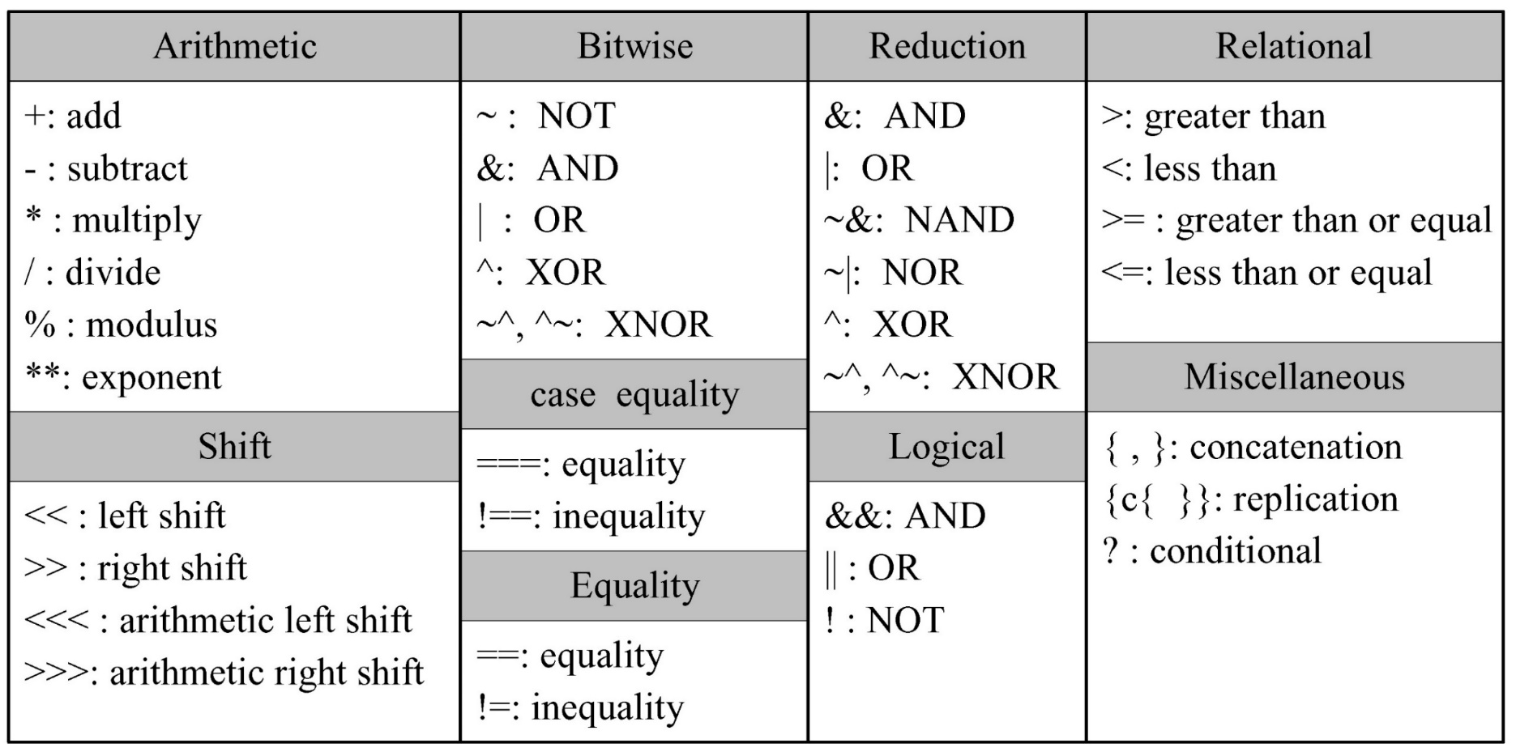
Operators

Slide 99
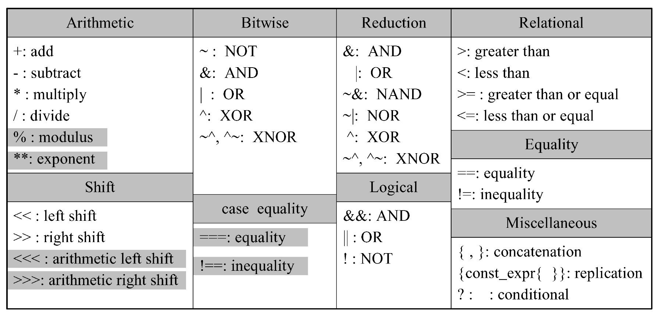
Synthesizable Operators

Slide 100
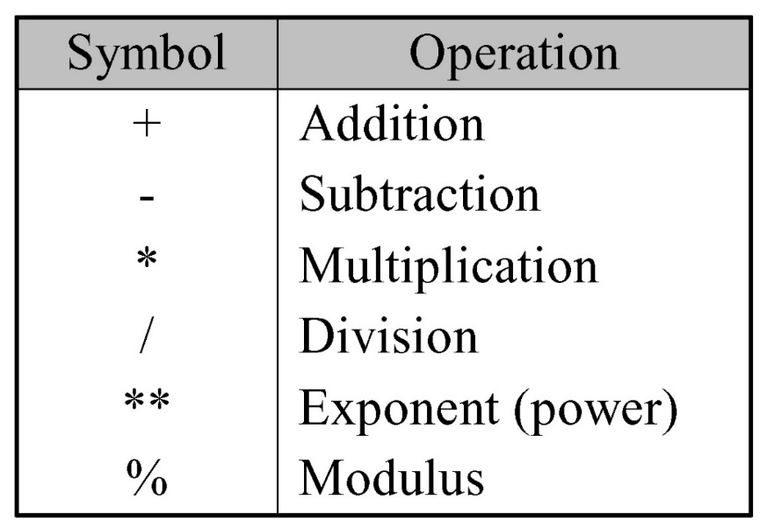
Arithmetic Operators
The result is x if any operand bit has a value x
Negative numbers except integer variable are represented as 2’s complement
-10/5 // -2
-`d10 / 5 // (2’s complement of 10) / 5 = (2³²-10) / 5

Slide 101
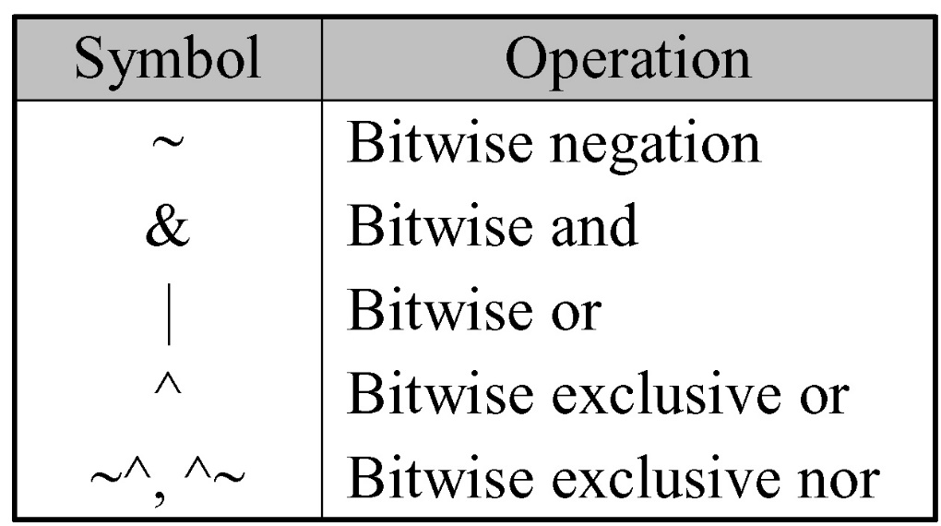
Bitwise Operators
A bit-by-bit operation
A z is treated as x
The shorter operand is zero-extended

Slide 102
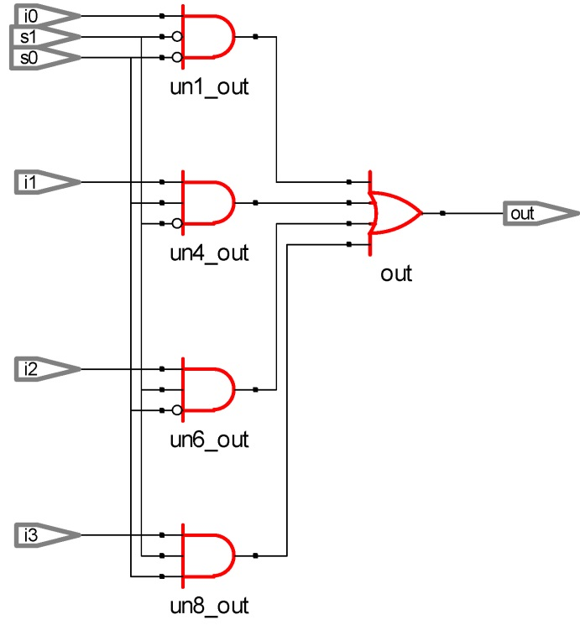
An Example: A 4-to-1 MUX
// using basic and, or , not logic operators
assign out = (~s1 & ~s0 & i0) |
(~s1 & s0 & i1) |
(s1 & ~s0 & i2) |
(s1 & s0 & i3) ;

Slide 103
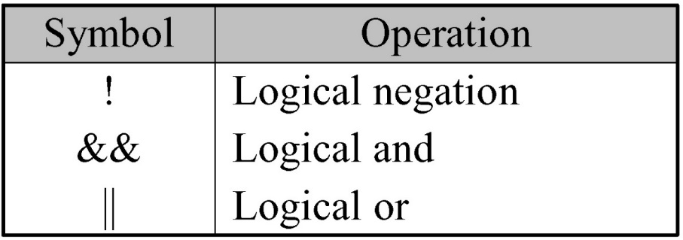
Logical Operators
Always evaluate to a 1-bit value, 0, 1, or x
The result is x (a false condition) if any operand bit is x or z
// A = 4'b1010,
B = 4'b1000
X | Y // 4’b1010
X || Y // 1
X & Y // 4’b1000
X && Y // 1

Slide 104
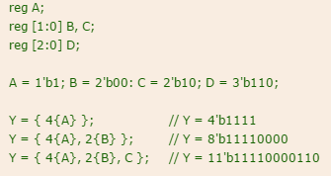
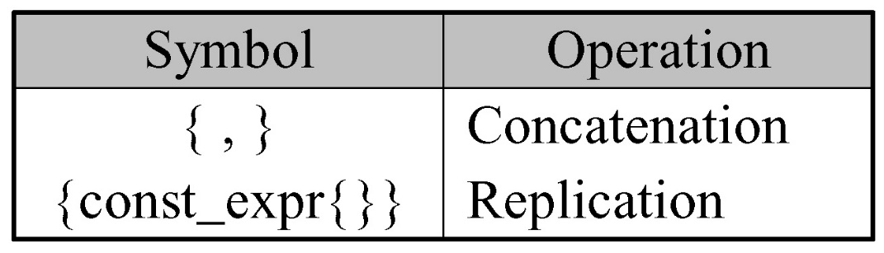
Concatenation/Replication Operators
Concatenation operator
y = {a, b[0], c[1]};
only for sized operand
Replication operator
y = {a, {4{b[0]}}, c[1]}; // y = {a, b[0], b[0], b[0], b[0], c[1]};

Slide 105
An Example: A 4-Bit Full Adder
module full_adder (c_out, sum, x, y); input x, y; output c_out, sum;
// specify the function of a 4-bit adder
assign {c_out, sum} = x + y + c_in;
endmodule

Slide 106
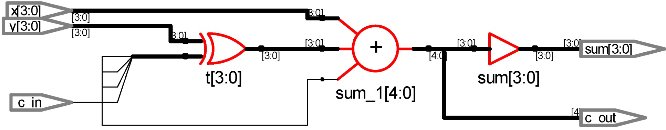
An Example: A 4-Bit Two’s Complement Adder
// specify the function of a two's complement adder
assign t = y ^ {4{c_in}};
assign {c_out, sum} = x + t + c_in;

Slide 107
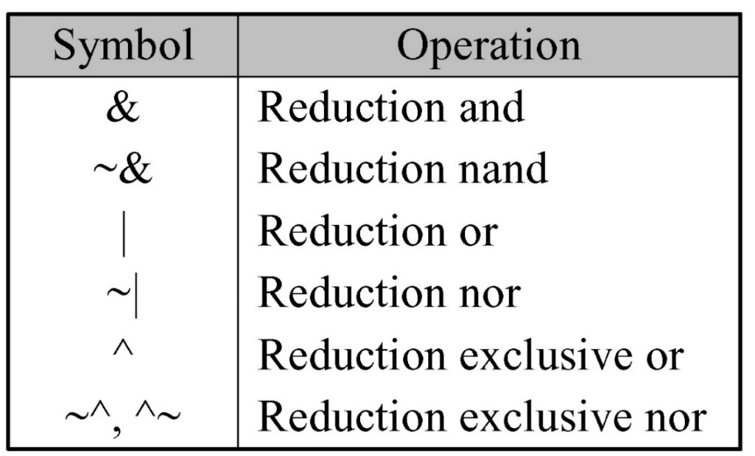
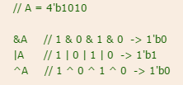
Reduction Operators
Perform only on one vector operand
Carry out a bit-wise operation
Yield a 1-bit result
Work bit by bit from right to left

Slide 108
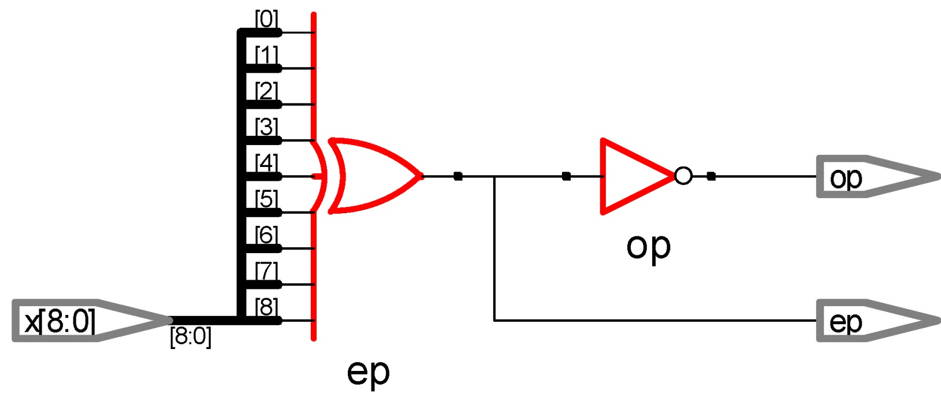
An Example: A 9-Bit Parity Generator
// dataflow modeling using reduction operator
assign ep = ^x; // even parity generator
assign op = ~^ep; // odd parity generator

Slide 109
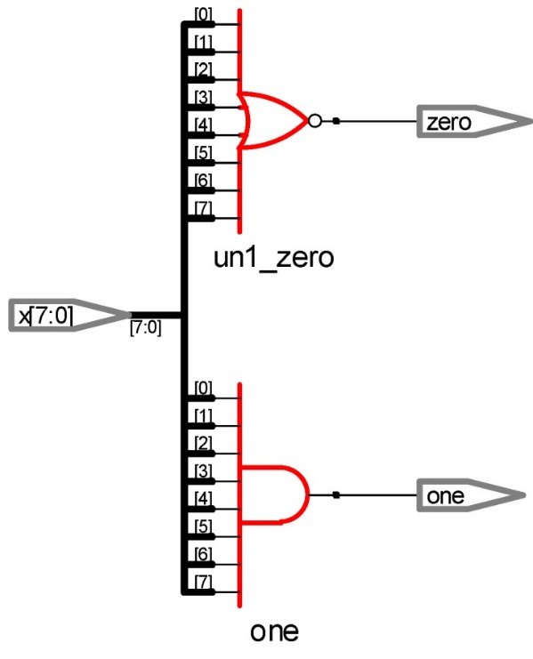
An Example: An All-Bit-Zero/One Detector
// dataflow modeling
assign zero = ~(|x); // all-bit zero
assign one = &x; // all-bit one

Slide 110
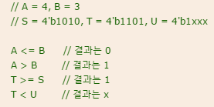
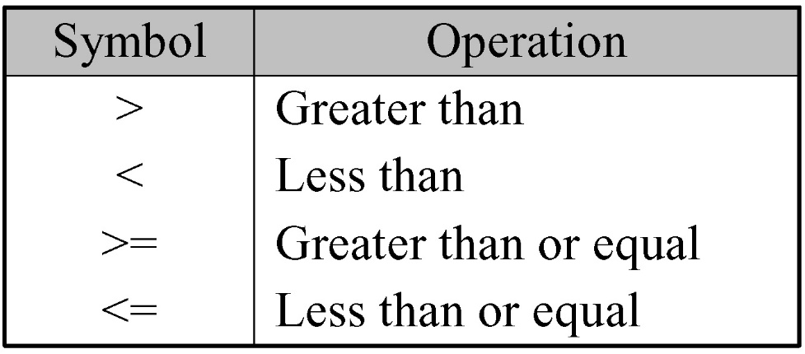
Relational Operators
The result is 1 if the expression is true and 0 if the expression is false
Return x if any operand bit is x or z

Slide 111
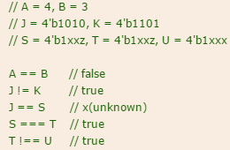
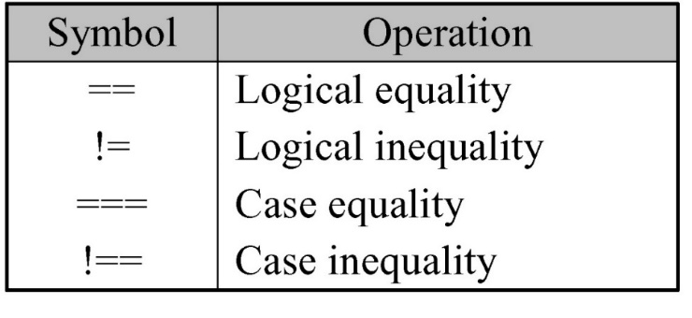
Equality Operators
Compare the two operands bit by bit
The shorter operand is zero-extended
Return 1 if the expression is true / 0 if the expression is false
The operators (==, !=)
yield an x if any operand bit is x or z
The operators (===, !==)
yield 1 if the two operands exactly match (‘x’ is also compared)
0 if the two operands not exactly match

Slide 112
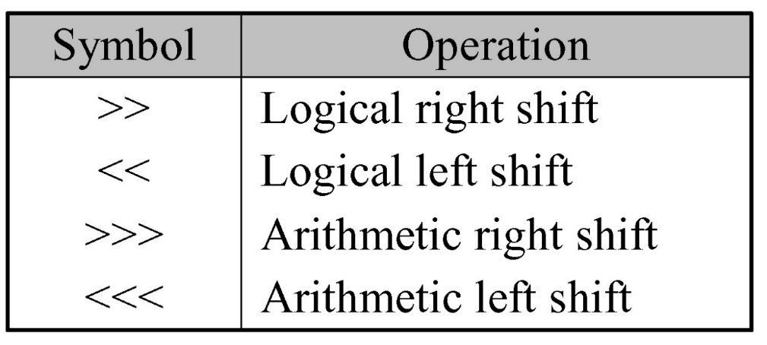
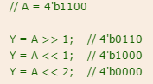
Shift Operators
Logical shift operators
0 is added in empty space
Arithmetic shift operators
0(<<<) or MSB(>>>) is added in empty space

Slide 113
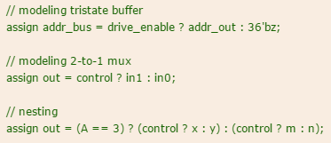
Conditional Operator
Usage: condition_expr ? true_expr: false_expr;
If condition_expr = x or z: the result = true_expr & false_expr (0 and 0 gets 0, 1 and 1 gets 1, others gets x )
Nesting is allowed
True_expr or Flase_expr can have condition
For example
assign out = selection ? in_1: in_0;

Slide 114
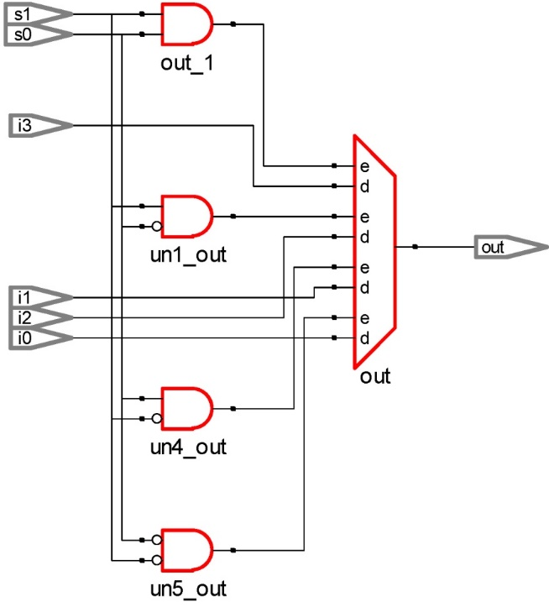
An Example: A 4-to-1 MUX
// using conditional operator (?:)
assign out = s1 ? ( s0 ? i3 : i2) : (s0 ? i1 : i0) ;

Slide 115
Operator Precedence
Operators | Operator Symbol | Precedence
Unary Multiply, Divide, Modulus | + - ! ~ * / % | Highest
Add, Subtract Shift | + - << >>
Relational Equality | < <= > >= == != === !==
Reduction Logical | &, ~& ^, ~^ |, ~| && | |
Conditional | ? : | Lowest

Slide 116
Synthesizable Operators

Slide 117
An initial Block
Execute exactly once during simulation
Start at simulation time 0 &
Operate independently (Parallel)
reg x, y, z;
initial begin // complex statement
x = 1`b0; y = 1`b1; z = 1`b0;
#10 x = 1`b1; y = 1`b1; z = 1`b1;
end
initial x = 1`b0; // single statement but not recommended

Slide 118


An initial Block

Slide 119
An always Block
Starts at simulation time 0
Executes continuously during simulation
Behavior modeling should be located inside of procedural constructs
reg clock;
initial clock = 1`b0; //clock initialization
//with initial
always #5 clock = ~clock; // cycle = 10, 100MHz
initial # 1000 $finish; // $finish with initial

Slide 120
Procedural Assignments
Syntax
variable_lvalue = [timing_control] expression
variable_lvalue <= [timing_control] expression
[timing_control] variable_lvalue = expression
[timing_control] variable_lvalue <= expression
lvalue : reg, integer, real, time (not net!!)
Two types
blocking
non-blocking

Slide 121
Blocking Assignments
Are executed in the specified order
Use the “=“ operator
Similar with C code
// blocking assignments
initial begin
x = #5 1'b0; // at time 5
y = #3 1'b1; // at time 8
z = #6 1'b0; // at time 14
end

Slide 122

An Example: Blocking Assignments

Slide 123
Non-Blocking Assignments
Use the “<=“ operator
Same with operator “<=“, distinguish by used position
Used to model several concurrent data transfers
reg x, y, z;
// nonblocking assignments
initial begin
x <= #5 1'b0; // at time 5
y <= #3 1'b1; // at time 3
z <= #6 1'b0; // at time 6
end

Slide 124

An Example: Non-Blocking Assignments

Slide 125


Intra-Assignment Delay Control
Intra-assignment delay control
Defers the assignment to the left-hand-side variable
Right side is already calculated
y = #25 ~x; // assign to y at time 25
count = #15 count + 1; // assign to count at time 40
y <= #25 ~x; // assign to y at time 25
count <= #15 count + 1; // assign to count at time 15

Slide 126
An Example: A 4-Bit Full Adder
module full_adder (c_out, sum, x, y); input x[3:0], y[3:0]; output c_out, sum[3:0];
// specify the function of a 4-bit adder
// #5 assign {c_out, sum} = x + y + c_in;
assign {c_out, sum} = #5 x + y + c_in;
endmodule

